Slide 1

REPUBLIC OF CAMEROON
---
PEACE – WORK – FATHERLAND
---
MINISTRY OF HIGHER EDUCATION
---
UNIVERSITY OF BUEA
REPUBLIQUE DU CAMEROON
---
PAIX – TRAVAIL – PATRIE
---
MINISTERE DE L’ENSEIGNEMENT SUPERIEURE
---
UNIVERSITE DE BUEA
FACULTY OF ENGINEERING AND TECHNOLOGY
---
DEPARTMENT OF COMPUTER ENGINEERING
PRESENTATION ON THE REQUIREMENT ANALYSIS PROCESS
Presented by
GROUP 13
Course Title: Internet Programming (J2EE) and Mobile Programming (CEF440)
Course Instructor: Dr. NKEMENI Valery
Academic year: 2024 -2025

Slide 2
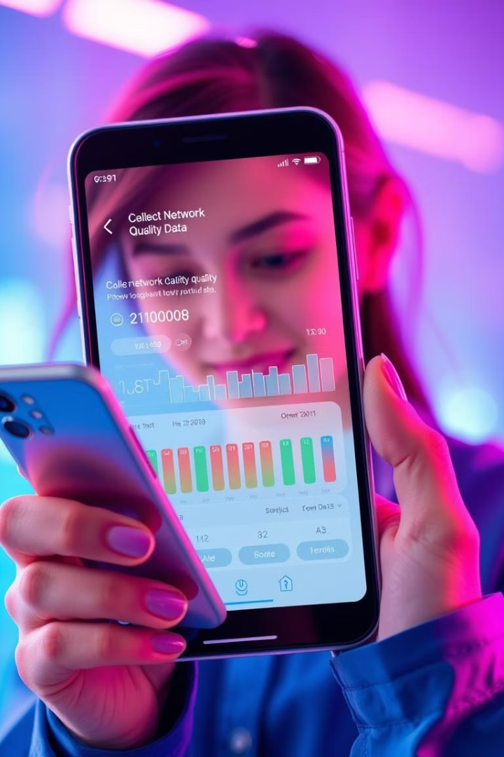
1
PRESENTATION OUTLINE
INTRODUCTION & PURPOSE
REQUIREMENT REVIEW, ANALYSIS & REFINEMENT
Project overview and objectives of the requirement analysis phase.
Analysis of gathered data and insights.
Assessment on the completeness, clarity, unambiguity, technical feasibility and dependency relationship of the requirements.
PRIORITIZATION OF REQUIREMENTS
REQUIREMENTS CLASSIFICATION
Identification of key frustration, user expectation and prioritization of requirements into high, medium and low priorities.
Classification of requirements into functional & Non-functional requirements.
REQUIREMENTS VALIDATION
CONCLUSION
Validation of user requirements through user surveys, use case scenarios and requirement traceability

Slide 3
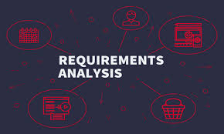
2
INTRODUCTION
OVERVIEW ON THE SCOPE OF THE PROJECT
The project involves designing and developing a mobile application capable of collecting both subjective (example: “Are you satisfied with the call quality?”) and objective QoE data (example: signal strength, network type, latency time, …) from mobile network subscribers in Cameroon
OBJECTIVE OF THE REQUIREMENT ANALYSIS PHASE
The general objective of the requirement analysis phase is to understand what the system is supposed to do and ensure that all stakeholders share a common, precise understanding of the product to be built

Slide 4

3
REVIEW & ANALYSIS OF GATHERED REQUIREMENTS
OVERVIEW ON SENTIMENT ANALYSIS AND CLUSTERING
From the gathered requirements, sentiment analysis was conducted in order to record qualitative analysis data. Also clustering was conducted in order to record quantitative analysis data.
ASSESSING THE COMPLETENESS & CLARITY OF REQUIREMENTS
The gathered requirements were analyzed and showed proves of completeness because the requirements showed evidence of user-covered needs, core features addressing and user role support.
In order to make these requirements cleared, we made use of clear definitions and validation methods to ensure unambiguous requirements.

Slide 5

4
IDENTIFICATION OF INCONSISTENCIES, AMBIGUITIES & MISSING INFOS
The gathered requirements were rigorously analyzed in order identify inconsistencies, ambiguity and missing information. This step is very crucial because it helps to identified and resolve these identified issues.
We need to note that, these issues can lead to:
Inconsistencies erode the trust between users and operators.
Ambiguity leads to rework.
Missing information causes delays
Background Tasks
Battery Optimization
Possible with Flutter with plugins support and native integration. Best on Android.
Possible (but indirectly) with Flutter by controlling how frequent background tasks run and avoiding high-battery-impact operations.
GPS Tracking
Stack Tools
Possible with Flutter with plugins like geolocator, location and google_maps_flutter.
Flutter, SQLite, Firebase, Figma, GitHub Actions

Slide 6
5
TECHNICAL FEASIBILITY & STACK EVALUATION
Background Tasks
Battery Optimization
Possible with Flutter with plugins support and native integration. Best on Android.
Possible (but indirectly) with Flutter by controlling how frequent background tasks run and avoiding high-battery-impact operations.
GPS Tracking
Stack Tools
Possible with Flutter with plugins like geolocator, location and google_maps_flutter.
Flutter, SQLite, Firebase, Figma, GitHub Actions

Slide 7
6
DEPENDENCY RELATIONSHIPS
FUNCTIONAL DEPENDENCIES
CROSS-MODULE DEPENDENCIES
This dependency relationship was used to outline the dependencies between the functional requirements via a matrix.
This dependency relationship was used to outline the dependencies between the various app’s modules (e.g. Data collection) via a matrix.
RISK-LINKED DEPENDENCIES
This dependency relationship was used to outline the dependency chain that may lead to potential risks together with the mitigation strategy.

Slide 8



7
PRIORITIZATION OF REQUIREMENTS
From the sentiment analysis conducted on the gathered requirements, we were able to obtain valuable insights about users’ feedback like: user frustration and user expectations.
Based on these collected insights, we were able to prioritize the requirements into high priority, medium priority and low priority.
High (core features) because they addresses the immediate pain points of the users.
Medium (enhancements) because it can be used to improve UX.
Low (future scope) because it is considered as nice-to-have features.
USER FRUSTRATIONS
USER EXPECTATIONS
Network performance issues
Data & Pricing Problems
“Silent data consumption”
Service Reliability
Customer Experience
Stable & Fast connectivity
Affordable, long-fasting data bundles
Transparency in data usage and billing
Better coverage in weak zones
Report issues and get resolutions

Slide 9
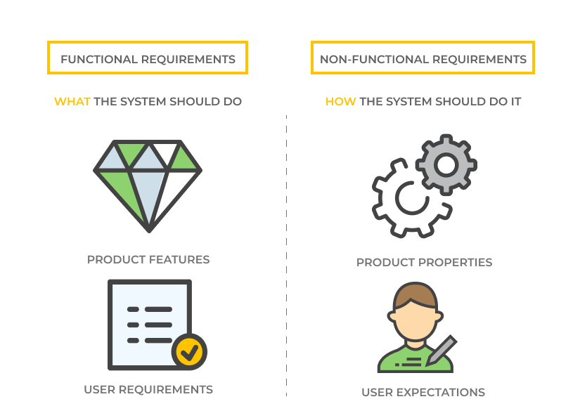
PRIORITIZED REQUIREMENTS
8
High Priority (Core features)
Real-time network issue reporting, data usage transparency dashboard, direct feedback channels to operators, network quality map and bundle recommendations.
1
Medium Priority (Enhancements)
2
Automated complaint escalation (ensures operators acknowledge reports), peak-hour alerts, user education on network optimization and operator response tracking (show if complaints are resolved).
Low Priority (Future scope)
3
Integration with operator API, AI-driven network diagnostics (for advanced troubleshooting) and community forums for users.

Slide 10


9
CLASSIFICATION OF REQUIREMENTS INTO FUNCTIONAL AND NON-FUNCTIONAL
We identified ten (10) functional requirements and five (5) non-functional requirements.
The classification of the functional requirements was done by defining the module in which it’s found and then giving a detail description of the requirement.
In a similar approach, the non-functional requirements were defined based on the system aspects that they tackle and then a detail descriptions of the requirement was done.

Slide 11

10
VALIDATION OF REQUIREMENTS
The validation of User requirements phase ensures that all specified requirements truly reflect the needs, expectations, and constraints of end-users and stakeholders. This phase involves confirming the accuracy, completeness, clarity, and feasibility of the requirements by making use of requirement validation techniques.
In order to validate the user requirements, we made use of the following techniques:
User survey
Use case scenarios
Traceability Matrix

Slide 12
11
CONCLUSION
The document presented the below important aspects
User-Centric Focus
Structured Prioritization
Clear Specifications
It addressed key pain points and translated it into core or high priority features.
Using priority levels, it defined an MVP and scalable enhancements plans.
It presented a comprehensive SRS which reduces ambiguity during implementation.

